Slide 1
Hearing Sound

Slide 2
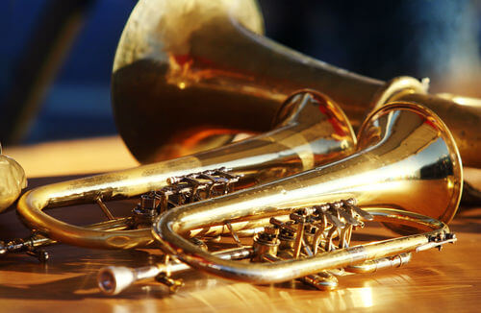
By the end of this lesson, you should:
Know and understand the structure of the ear.
Be able to identify the functions each ear segment has.
Be able to identify how sound is passed into the brain.

Slide 3

We use our ears to hear.
We use our ears to transform vibrations in the air into a form that our brains can understand and interpret as sound.
This is a very complicated process!

Slide 4


Slide 5

The ear has three main sections.
These are the outer ear, middle ear and inner ear.
In this Smart Lesson, we will explore how these sections work together to allow us to hear.

Slide 6

The outer ear has two main parts.
The flappy bit of cartilage on the side of your head is the pinna which is part of the outer ear.
The pinna is used to funnel sound from the environment into the ear canal.

Slide 7
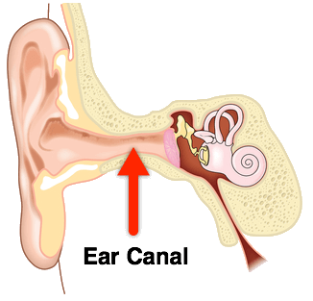
The ear canal is also a part of the outer ear.
The function of the ear canal is to move sound from the pinna to the ear drum, which is in the middle ear.
The ear canal is a tube which is around 2.5 cm long and about 0.7 cm wide. It's very small to have such an important function!

Slide 8
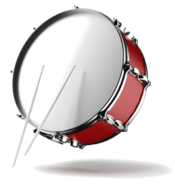
The middle ear has a membrane and a group of bones.
The middle ear consists a group of bones called the ossicles.
The ear drum separates the outer ear from the inner ear.

Slide 9
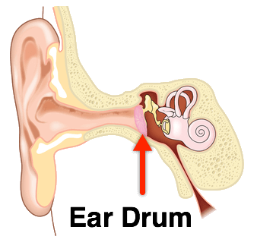
The ear drum is a very thin flap of skin called a membrane.
Sound waves travel down the ear canal and vibrate the ear drum. The ear drum then passes these vibrations to the ossicles.

Slide 10
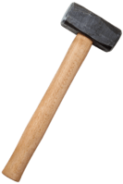
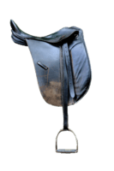
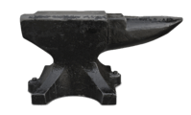
The ossicles are some of the smallest bones in the human body.
The three bones which make up the ossicles are the hammer, the stirrup and the anvil.

Slide 11
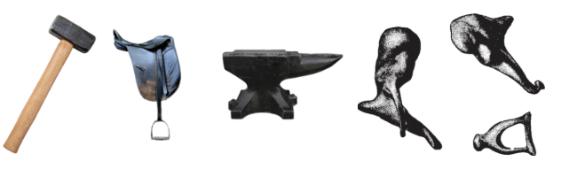
The ossicles are used to magnify vibrations from sound waves.
These vibrations are then transmitted to the inner ear through the oval window.

Slide 12
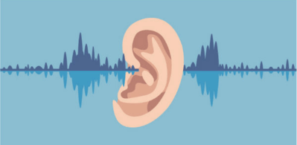
The inner ear is the final section of the ear.
It is linked to the middle ear by the oval window.
This is a small opening which is covered by a thin membrane. It transmits vibrations from the middle ear to the inner ear.

Slide 13
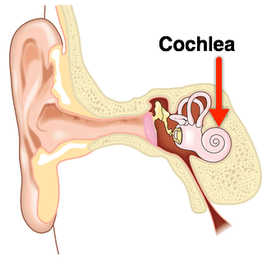
The inner ear contains the cochlea and the semicircular canals.
The cochlea is a spiral shaped tube which is filled with fluid. This fluid vibrates, and this vibration is detected by tiny hairs which line the cochlea.

Slide 14
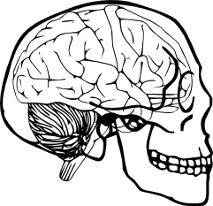
These hairs are connected to the auditory nerve.
This nerve transmits the impulses from the hairs in the cochlea to the brain.
Our brain is able to interpret these electrical impulses as sound!

Slide 15

The semicircular canals are also a part of the inner ear. However, they are used for balance rather than hearing.

